Slide 1
Network+ Guide to Networks Eighth Edition
Chapter 3
Addressing on Networks
© 2019 Cengage. All Rights Reserved. May not be copied, scanned, or duplicated, in whole or in part, except for use as permitted in a license distributed with a certain product or service or otherwise on a password-protected website for classroom use.

Slide 2
Objectives (1 of 2)
3.1 Find the MAC address of a computer and explain its function in network communications
3.2 Configure T C P/I P settings on a computer, including I P address, subnet mask, default gateway, and D N S servers
3.3 Explain the purpose of ports and sockets, and identify the ports of several common, network protocols

Slide 3
Objectives (2 of 2)
3.4 Describe domain names and the name resolution process
3.5 Use command-line tools to troubleshoot problems with network addresses

Slide 4
Addressing Overview
Four addressing methods:
Data Link layer MAC address
48 bits, written as six hex numbers separated by colons
Also called physical address
Network layer I P address
I P v 4 addresses have 32 bits and are written as four decimal numbers called octets
I P v 6 addresses have 128 bits and are written as eight blocks of hexadecimal number
Transport layer port numbers
Application layer F Q D Ns, computer names, and host names
Fully qualified domain name (F Q D N)—A unique character-based name
© 2019 Cengage. All Rights Reserved. May not be copied, scanned, or duplicated, in whole or in part, except for use as permitted in a license distributed with a certain product or service or otherwise on a password-protected website for classroom use.

Slide 5
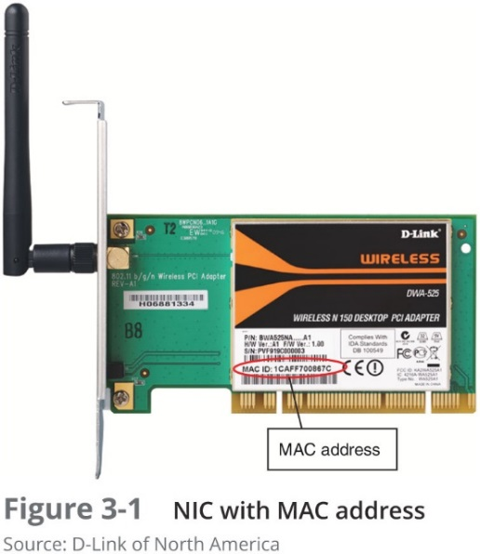
MAC Addresses
Traditional MAC addresses contain two parts:
First 24 bits are known as the O U I (Organizationally Unique Identifier) or manufacturer-I D
Assigned by the I E E E
Last 24 bits make up the extension identifier or device I D
Manufacturers assign each N I C a unique device I D

Slide 6
I P Addresses (1 of 2)
Static I P addresses are assigned manually by the network administrator
Dynamic I P addresses are automatically assigned by a D H C P (Dynamic Host Configuration Protocol) server
You’ll learn more about D H C P later in the chapter
To view T C P/I P settings on a Windows 10 computer:
In Control Panel, open the Network and Sharing Center. Click Change adapter settings
Brief explanation of settings:
Gateway—Device that nodes use for access to the outside world
Subnet mask—Used to indicate what portion of an I P address is the network portion (network I D) and what part is the host portion (host I D)
D N S server—Server responsible for tracking computer names and their I P addresses

Slide 7
I P Addresses (2 of 2)
You can use the ipconfig utility in a Command Prompt to find out current T C P/I P settings
Two types of I P addresses:
I P v 4—A 32-bit address
I P v 6—A 128-bit address

Slide 8
I P v 4 Addresses (1 of 7)
I P v 4 addresses
32-bit address organized into four groups of 8 bits each (known as octets)
Each of the four octets can be any number from 0 to 255
Some I P addresses are reserved
Example of an I P v 4 address: 72.56.105.12

Slide 9
I P v 4 Addresses (2 of 7)
Classful addressing
The dividing line between the network and host portions is determined by the numerical range the IP address falls in
Classful I P v 4 addresses are divided into five classes:
Class A, Class B, Class C, Class D, and Class E
Classes A, B, and C licensed IP addresses are available for use on the Internet
Called public IP addresses
A company can use private I P addresses on its private networks
I E E E recommends the following I P addresses be used for private networks:
10.0.0.0 through 10.255.255.255
172.16.0.0 through 172.31.255.255
192.168.0.0 through 192.168.255.255

Slide 10
I P v 4 Addresses (3 of 7)
Table 3-1 I P address classes
Class | Network octets* | Approximate number of possible networks | Approximate number of IP addresses in each network
A | 1.x.y.z to 126.x.y.z | 126 | 16 million
B | 128.0.x.y to 191.255.x.y | 16,000 | 65,000
C | 192.0.0.x to 223.255.255.x | 2 million | 254

Slide 11
I P v 4 Addresses (4 of 7)
Classes D and E addresses were not available for general use:
Class D begin with octets 224–239 and are used for multicasting
Class E begin with octets 240–254 and are used for research
Table 3-2 Reserved I P addresses
IP address(es) | Function
255.255.255.255 | Used for broadcast messages by TCP/IP background processes. A broadcast message is read by every node on the network.
0.0.0.0 | Currently unassigned
127.0.0.1 through 127.255.255.254 | Used for research or can indicate your own computer, in which case it is called the loopback address.
169.254.0.1 through 169.254.255.254 | Used to create an A P I P A (Automatic Private IP Addressing) address when a computer configured for D H C P first connects to the network and is unable to lease an IPv4 address from the D H C P server.

Slide 12
I P v 4 Addresses (5 of 7)
Network Address Translation (N A T)—A technique designed to conserve public I P addresses needed by a network
Address translation—Process where a gateway device substitutes the private I P addresses with its own public address
When these computers need access to other networks or Internet
Port Address Translation (P A T)—Process of assigning a TCP port number to each ongoing session between a local host and Internet host

Slide 13
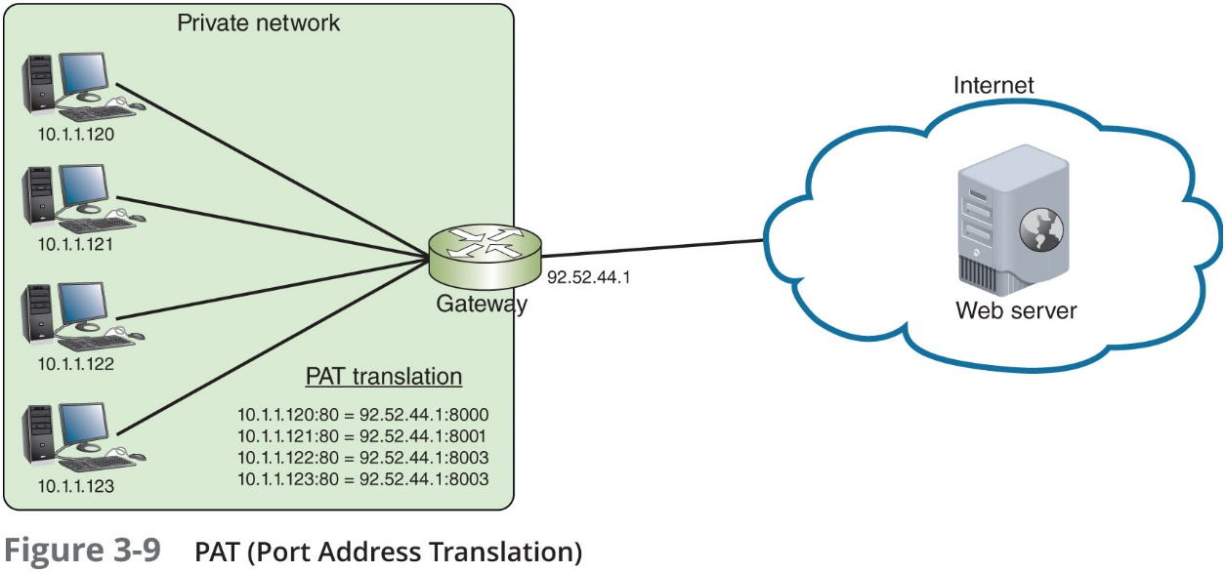
I P v 4 Addresses (6 of 7)

Slide 14
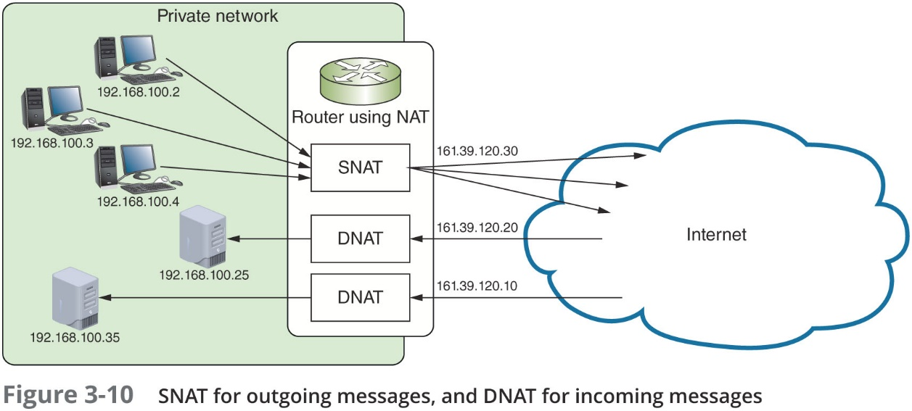
I P v 4 Addresses (7 of 7)
Two variations of N A T to be aware of:
S N A T (Static (or Source) Network Address Translation)—The gateway assigns the same public IP address to a host each time it makes a request to access the Internet
D N A T (Dynamic Network Address Translation)—The gateway has a pool of public address that it is free to assign to a local host when it makes a request to access the Internet

Slide 15
I P v 6 Addresses (1 of 7)
An I P v 6 address has 128 bits written as eight blocks of hexadecimal numbers separated by colons:
For example, 2001:0000:0B80:0000:0000:00D3:9C5A:00CC
Each block is 16 bits
Leading zeros in a four-character hex block can be eliminated
If blocks contain all zeroes, they can be written as double colons (::), only one set of double colons is used in an I P address
Therefore, above example can be written two ways:
2001::B80:0000:0000:D3:9C5A:CC
2001:0000:B80::D3:9C5A:CC (preferred method because it contains fewest zeroes)

Slide 16
I P v 6 Addresses (2 of 7)
I P v 6 terminology:
Link (sometimes called local link)—Any LAN bounded by routers
An interface is a node’s attachment to a link
Dual stacked—When a network is configured to use both I P v 4 and I P v 6
Tunneling—A method used by I P v 6 to transport I P v 6 packets through or over an I P v 4 network
Interface I D—The last 64 bits or four blocks of an I P v 6 address that identify the interface
Neighbors—Two or more nodes on the same link

Slide 17
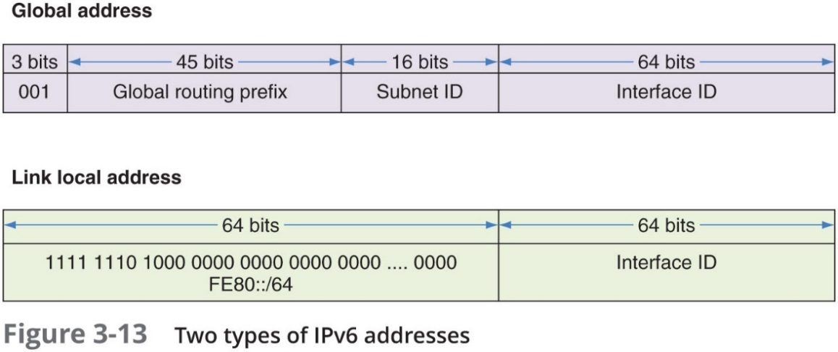
I P v 6 Addresses (3 of 7)
Types of I P v 6 addresses:
Unicast address—Specifies a single node on a network
Global unicast address—Can be routed on the Internet
Link local unicast address—Can be used for communicating with nodes in the same link
Multicast address—Packets are delivered to all nodes on a network
Anycast address—Can identify multiple destinations, with packets delivered to the closest destination

Slide 18
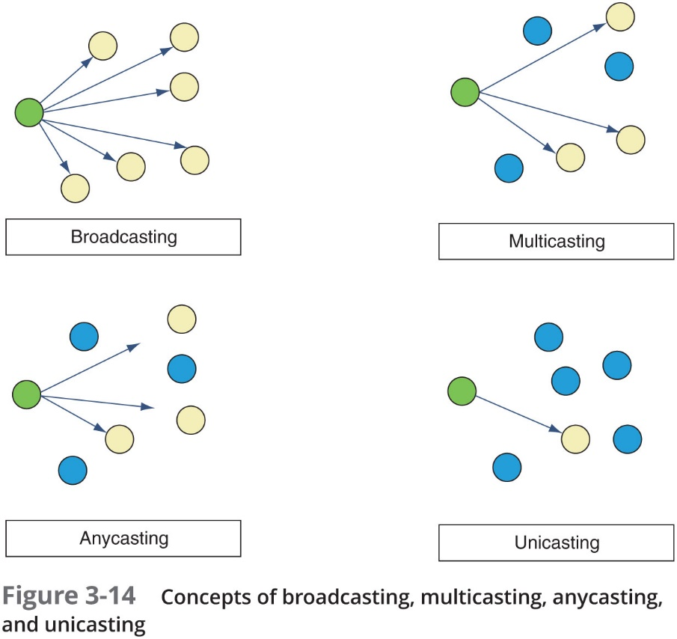
I P v 6 Addresses (4 of 7)

Slide 19
I P v 6 Addresses (5 of 7)
Table 3-3 Address prefixes for types of I P v 6 addresses
IP address type | Address prefix | Notes
Global unicast | 2000::/3 | First 3 bits are always 001
Link local unicast | F E 80::/64 | First 64 bits are always 1111 1110 1000 0000 0000 0000 …. 0000
Unique local unicast | FC00::/7 | First 7 bits are always 1111 110
blank | FD00::/8 | First 8 bits are always 1111 1101
Multicast | FF00::/8 | First 8 bits are always 1111 1111

Slide 20
I P v 6 Addresses (6 of 7)
Auto configuration:
I P v 6 addressing is designed so that a computer can autoconfigure its own link local I P address
Similar to how I P v 4 uses an A P I P A address
Step 1—The computer creates its I P v 6 address:
Uses F E 8 0::/64 as the first 64 bits (called prefix)
Last 64 bits can be generated in two ways:
Randomly generated
Generated from the network adapter’s MAC address
Step 2—The computer checks to make sure its I P address is unique on the network

Slide 21
I P v 6 Addresses (7 of 7)
Step 3—The computer asks if a router on the network can provide configuration information (message is called a R S or router solicitation)
If a router responds with D H C P information, the computer uses whatever information this might be (called a R A or router advertisement)
Such as the I P addresses of D N S server or the network prefix
Process is called prefix discovery
The computer uses the prefix to generate its own link local or global I P v 6 address by appending its interface I D to the prefix

Slide 22
Ports and Sockets (1 of 3)
Port numbers—Ensure data is transmitted to the correct process among multiple processes running on the computer
Socket—Consists of host’s I P address and the port number of an application running on the host:
Colon separates the two values
Example—10.43.3.87:23
Port numbers are divided into three types:
Well-known ports—0 to 1023
Registered ports—1024 to 49151
Dynamic and private ports—49152 to 65535

Slide 23
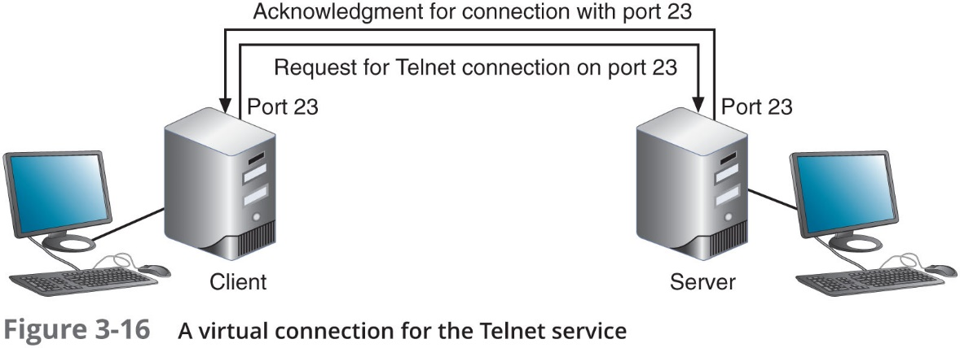
Ports and Sockets (2 of 3)

Slide 24
Ports and Sockets (3 of 3)
Protocols not yet covered:
T F T P (Trivial File Transfer Protocol)
N T P (Network Time Protocol)
L D A P (Lightweight Directory Access Protocol)
S M B (Server Message Block)
S I P (Session Initiation Protocol)
H.323

Slide 25
Domain Names and D N S (Domain Name System) (1 of 3)
Character-based names are easier to remember than numeric I P addresses
Last part of an F Q D N is called the top-level domain (T L D)
Domain names must be registered with an Internet naming authority that works on behalf of I C A N N
I C A N N restricts what type of hosts can be associated with .arpa, .mil, .int, .edu, and .gov
Name resolution is the process of discovering the I P address of a host when you know the F Q D N

Slide 26
Domain Names and D N S (Domain Name System) (2 of 3)
Table 3-5 Some well-known top-level domains
Domain suffix | Type of organization
ARPA | Reverse lookup domain (special Internet function)
COM | Commercial
EDU | Educational
GOV | Government
ORG | Noncommercial organization (such as a nonprofit agency)
NET | Network (such as an ISP)
MIL | United States military organization
BIZ | Businesses
INFO | Unrestricted use

Slide 27
Domain Names and DNS (Domain Name System) (3 of 3)
D N S is an Application layer client-server system of computers and databases made up of these elements:
namespace—The entire collection of computer names and their associated IP addresses stored in databases on D N S name servers around the globe
name servers—Hold databases, which are organized in a hierarchical structure
resolvers—A D N S client that requests information from D N S name servers

Slide 28
Namespace Databases
Each organization that provides host services is responsible for providing and maintaining its own D N S authoritative servers for public access
Authoritative server is the authority on computer names and their IP addresses for computers in their domains
The domains that the organization is responsible for managing are called a D N S zone

Slide 29
Name Servers (1 of 4)
Four common types of D N S servers:
Primary D N S server—The authoritative name server for the organization
Holds the authoritative DNS database for the organization’s zones
Secondary D N S server—Backup authoritative name server for the organization
Caching D N S server—Accesses the public D N S data and caches the D N S information it collects
Forwarding D N S server—Receives queries from local clients but doesn’t work to resolve the queries
Any of these server types can co-exist on the same machine

Slide 30
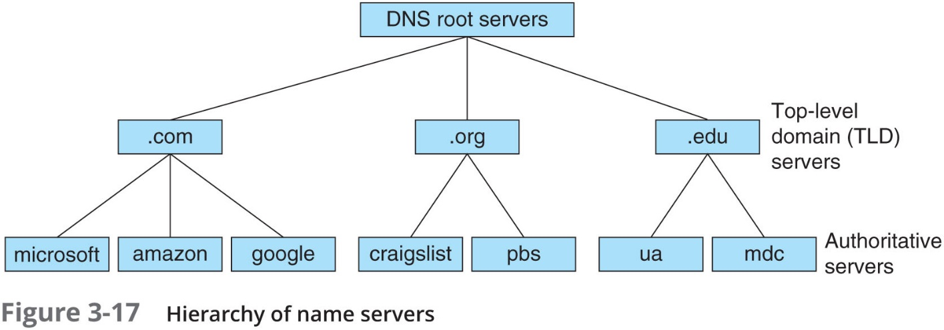
Name Servers (2 of 4)
D N S name servers are organized in a hierarchical structure
At the root level, 13 clusters of root server hold information used to locate top-level domain (T L D) servers
T L D servers hold information about authoritative servers owned by various organizations

Slide 31
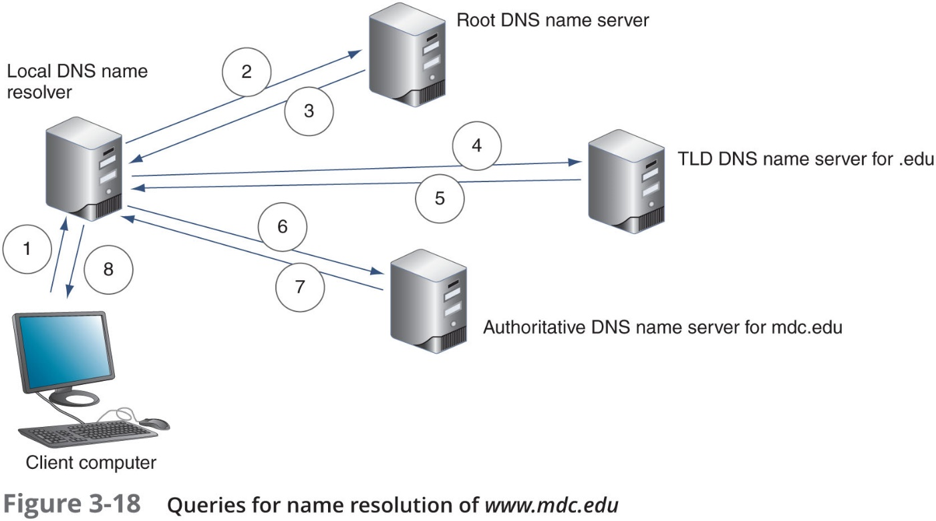
Name Servers (3 of 4)

Slide 32
Name Servers (4 of 4)
Ways the resolution process can get more complex:
Caching server typically is not the same machine as the authoritative server
Caching server exists only to resolve names for its own local clients
Name servers within a company might not have access to root servers
A T L D name server might be aware of an intermediate name server rather than the authoritative name server
Two types of D N S requests:
Recursive—A query that demands a resolution or the answer “It can’t be found”
Iterative—A query where the local server issues queries to other servers
Other servers only provide information if they have it
Do not demand a resolution

Slide 33
Resource Records in a D N S Database
Several types of records, called resource records are kept in a D N S database:
A (Address) record—Stores the name-to-address mapping for a host
A A A A (Address) record—Holds the name-to-address mapping, the I P address is an I P v 6 type I P address
C NAME (Canonical Name) record—Holds alternative names for a host
P T R (Pointer) record—Used for reverse lookups
N S (Name Server) record—Indicates the authoritative name server for a domain
M X (Mail Exchanger) record—Identifies a mail server and is used for email traffic
S R V (Service) record—Identifies the hostname and port of a computer that hosts a specific network services besides email
T X T (Text) record—Holds any type of free-form text

Slide 34
D N S Server Software (1 of 2)
BIND (Berkeley Internet Name Domain)—Most popular D N S server software
Open source—The term for software whose code is publicly available for use and modification
Microsoft D N S Server—Built-in D N S service in the Windows Server O S
For a more secure network:
Internal and external DNS queries should be handled by different DNS servers
Can use a firewall to filter or block traffic between networks
D M Z or demilitarized zone
Area between two firewalls

Slide 35
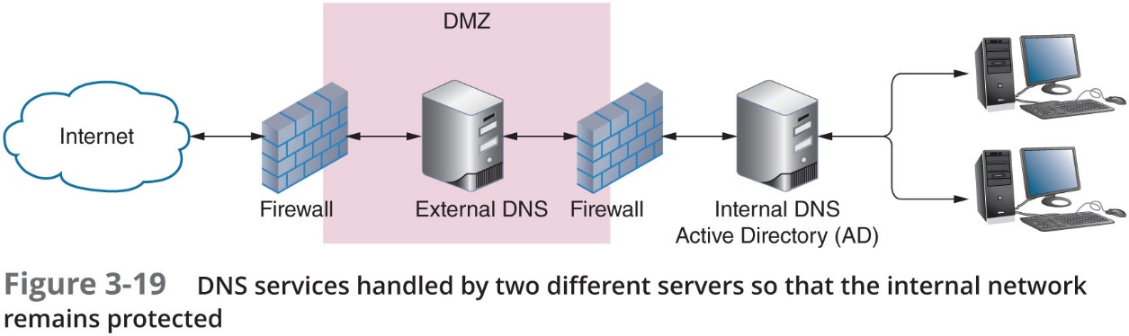
D N S Server Software (2 of 2)

Slide 36
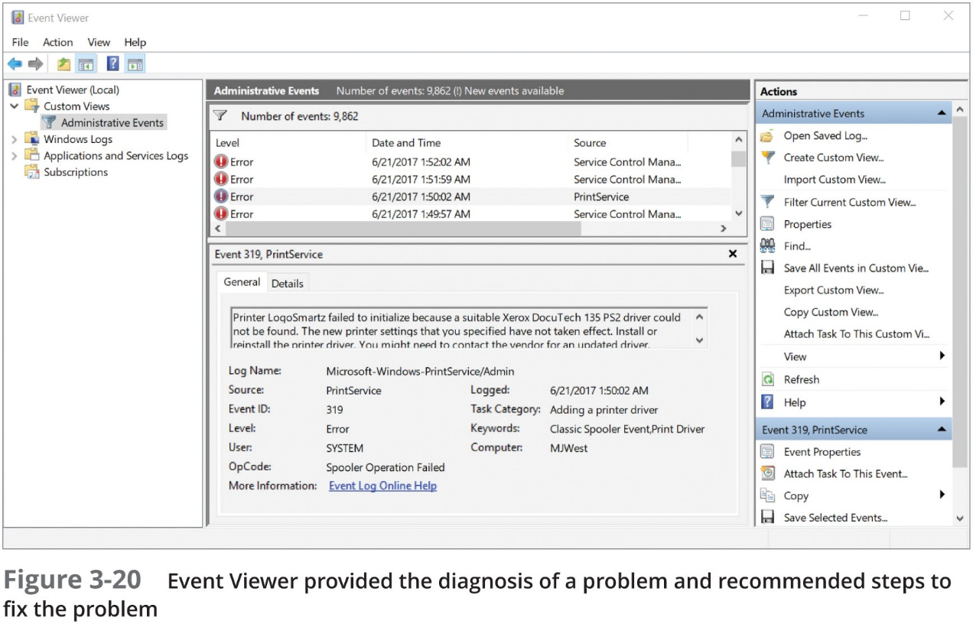
Troubleshooting Address Problems
Event Viewer—One of the first places to start looking for clues when something goes wrong

Slide 37
Troubleshooting Tools (1 of 12)
Command-link tools are a great resource to troubleshoot network problems
Some of the most helpful tools:
ping
i pconfig (Windows only)
ifconfig (Linux only)
nslookup
dig (Linux only)

Slide 38
Troubleshooting Tools (2 of 12)
ping (Packet Internet Groper)—Used to verify that T C P/I P is:
Installed
Bound to the N I C
Configured correctly
Communicating with the network
The ping utility sends out a signal called an echo request to another device (request for a response)
Other computer responds in the form of an echo reply
I C M P (Internet Control Message Protocol)—Protocol used by the echo request/reply to carry error messages and information about the network

Slide 39
Troubleshooting Tools (3 of 12)
I P v 6 networks use a version of I C M P called I C M P v 6:
ping6—On Linux computers running IPv6, use ping6 to verify whether an IPv6 host is available
ping -6—On Windows computers, use ping with the -6 switch to verify connectivity on I P v 6 networks
For the ping6 and ping -6 commands to work over the Internet, you must have access to the I P v 6 Internet

Slide 40
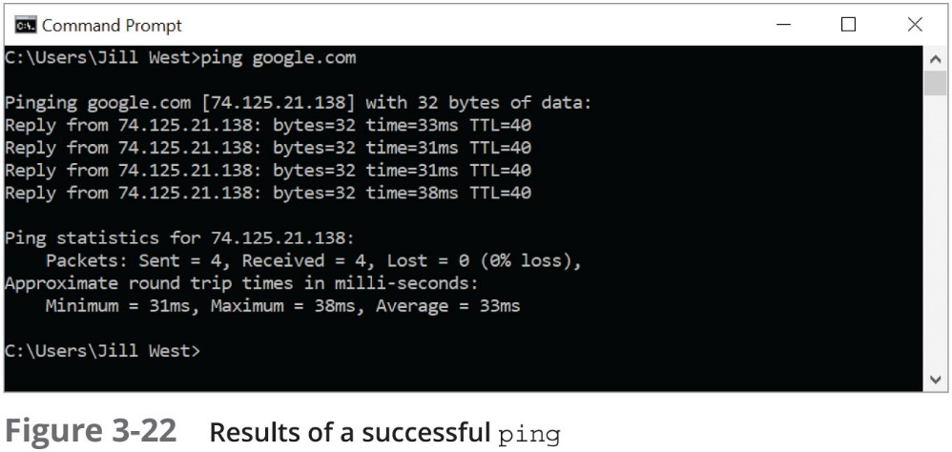
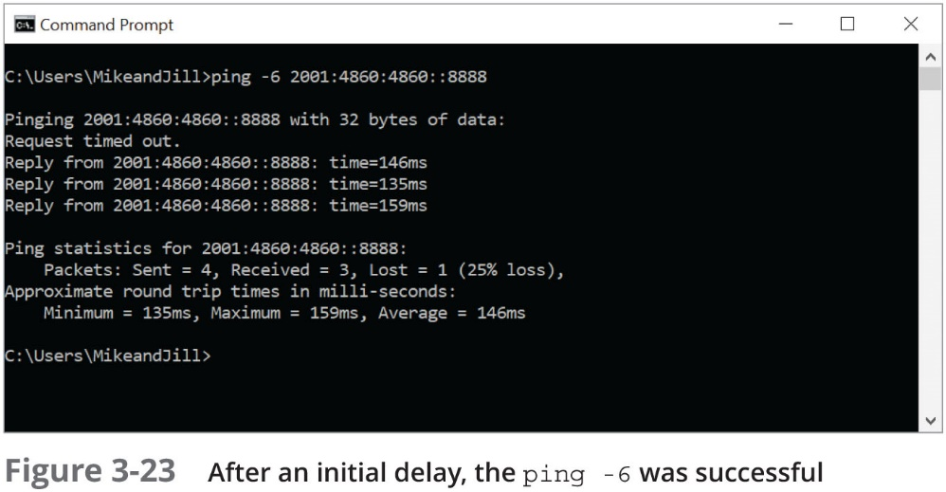
Troubleshooting Tools (4 of 12)

Slide 41
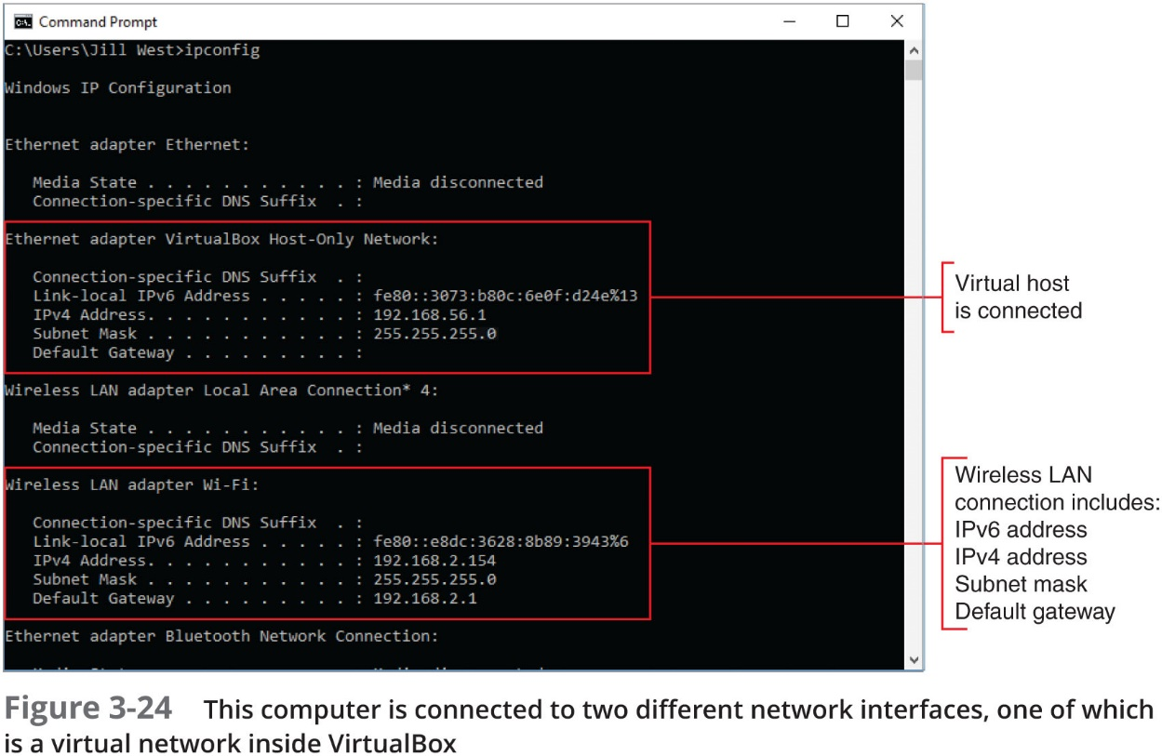
Troubleshooting Tools (5 of 12)
ipconfig—Shows current T C P/I P addressing and domain name information on a Windows computer
Use ipconfig/all to see a more complete summary of T C P/I P addressing information

Slide 42
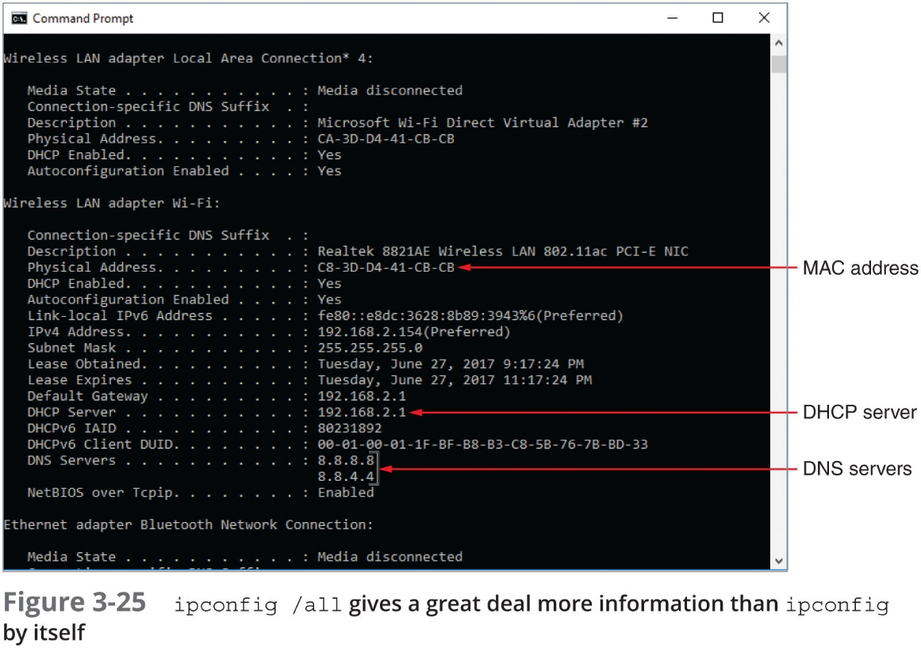
Troubleshooting Tools (6 of 12)
ipconfig—Shows current T C P/I P addressing and domain name information on a Windows computer
Use ipconfig/all to see a more complete summary of T C P/I P addressing information

Slide 43
Troubleshooting Tools (7 of 12)
ifconfig—Utility to view and manage T C P/I P settings
If your Linux or UNIX system provides a G U I
Open a shell prompt, then type ifconfig
Table 3-9 Some ifconfig commands
ifconfig command | Description
ifconfig | Displays basic TCP/IP information and network information, including MAC address of the N I C
ifconfig -a | Displays TCP/IP information associated with every interface on a Linux device; can be used with other parameters (see Figure 3-26)
ifconfig down | Marks the interface, or network connection, as unavailable to the network
ifconfig up | Reinitializes the interface after it has been taken down (via the ifconfig down command), so that it is once again available to the network
man ifconfig | Displays the manual pages, called man pages, for the ifconfig command, which tells you how to use the command and about command parameters (similar to the ipconfig /? command in Windows)

Slide 44
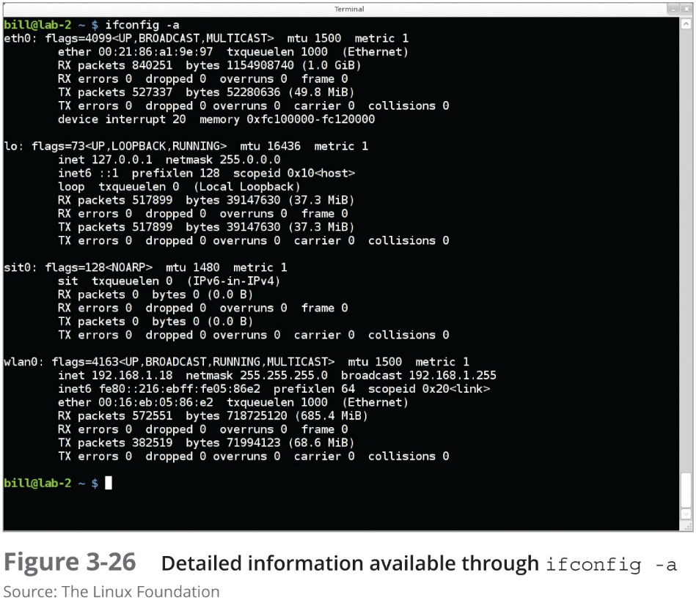
Troubleshooting Tools (8 of 12)

Slide 45
Troubleshooting Tools (9 of 12)
n s lookup (name space lookup)—Allows you to query the D N S database from any computer on a network:
To find the host name of a device by specifying its I P address, or vice versa
Useful for verifying a host is configured correctly or for troubleshooting D N S resolution problems
Reverse D N S lookup—To find the host name of a device whose I P address you know
ns lookup 69.23.208.74
Two modes:
Interactive—To test multiple D N S servers at one time
Noninteractive—Test a single D N S server

Slide 46
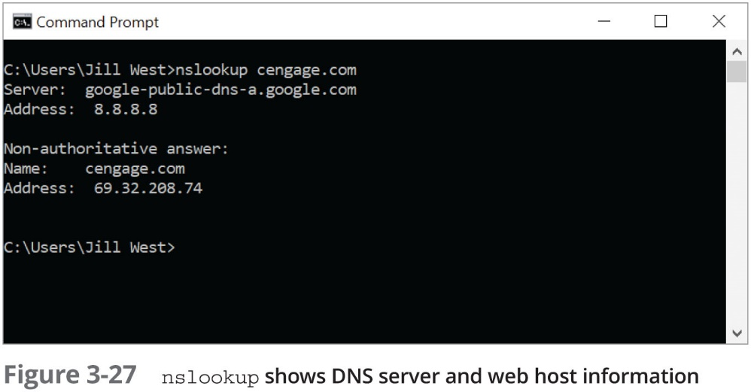
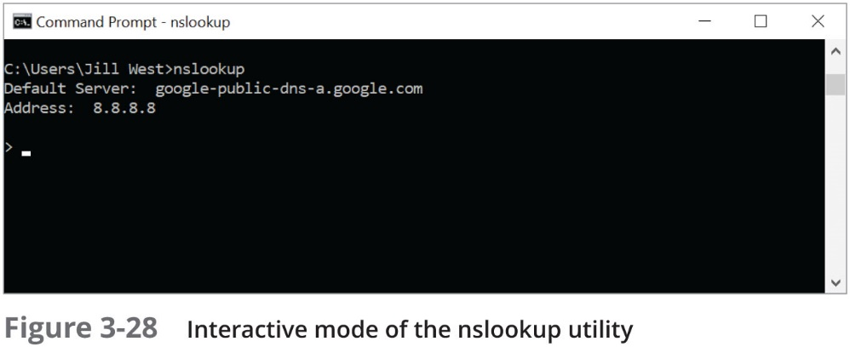
Troubleshooting Tools (10 of 12)

Slide 47
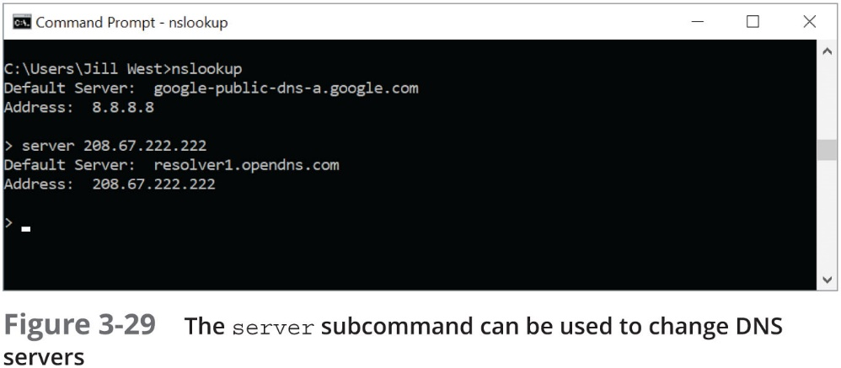
Troubleshooting Tools (11 of 12)
You can change D N S servers from within interactive mode with the server subcommand and specifying the IP address of the new D N S server
To exit nslookup’s interactive mode, enter exit

Slide 48
Troubleshooting Tools (12 of 12)
dig (domain information groper)—Available on Linux and macO S
Provides more detailed information than nslookup and uses more reliable sources of information to output its results
Table 3-10 Sample dig commands
Sample dig commands | Description
dig google.com | Performs a D N S lookup on a domain name
dig @8.8.8.8 google.com | Specifies a name server in the google.com domain
dig @8.8.8.8 google.com MX | Requests a list of all A records in the google.com domain on a specific name server
dig google.com ANY | Requests a list of all record types in the google.com domain
dig –x 74.125.21.102 | Performs a reverse lookup on a Google I P address
man dig | Displays the man page for the dig command

Slide 49
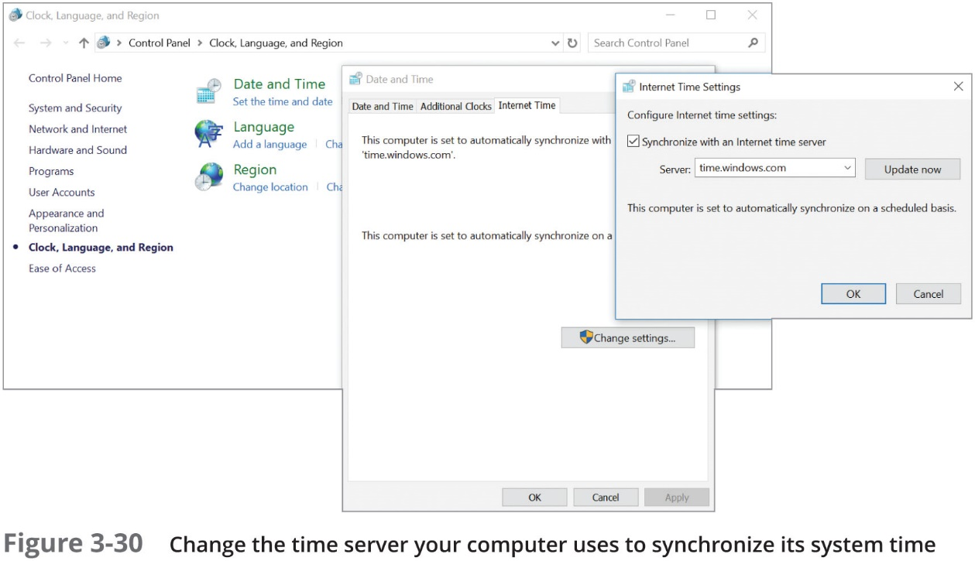
Common Network Issues (1 of 3)
Incorrect time
Check a domain computer’s time source from a Command Prompt window by entering w32tm /query /source

Slide 50
Common Network Issues (2 of 3)
D H C P issues:
If you are getting D H C P errors or if multiple clients are having trouble connecting to the network
Check the settings on your D H C P server
Make sure the D H C P scope is large enough to account for the number of clients the network must support
Consider implementing a shorter lease time on larger networks

Slide 51
Common Network Issues (3 of 3)
Network connection configuration issues
Common configuration errors:
Incorrect netmask
Incorrect gateway
Duplicate IP address
When a computer is struggling to establish a network connection
Check its T C P/I P configuration settings
If the computer is not obtaining an I P address and related information from a D H C P server
Static settings might be using the wrong information
Try switching to D H C P

Slide 52
Chapter Summary (1 of 3)
The I A N A is an organization responsible for tracking the assignments of domain names, port numbers, and IP addresses
MAC addresses contain two parts, are 48 bits long, and are written in hexadecimal numbers separated by colons
I P addresses identify nodes at the Network layer
The first part of an I P v 4 address identifies the network and the last part identifies the host
A D H C P scope is a range of addresses to be assigned to clients when they request an I P v 4 address
A gateway device that stands between a private network and other networks substitutes the private I P address with its own public address when computers need access to other networks or the Internet

Slide 53
Chapter Summary (2 of 3)
I P v 6 standards were developed to improve routing capabilities and speed communication over the established I P v 4 standards
I P v 6 addressing is designed so that a computer can autoconfigure its own link local I P address
A port number is a number, assigned to a process:
T C P and U D P ports ensure that data is transmitted to the correct process among multiple process running on the computer
Name resolution is the process of discovering the IP address of a host when its F Q D N is known
Namespace databases are stored in D N S zone files
The most popular D N S server software is BIND

Slide 54
Chapter Summary (3 of 3)
Troubleshooting utilities and tools:
Event Viewer, ping, ipconfig, ifconfig (Linux only), nslookup, and dig (Linux only)
If your computer is not a member of a domain, you can determine and adjust the time server your computer syncs to when it connects to the Internet
Make sure the D H C P scope is large enough to account for the number of clients the network must support
If the computer is not obtaining an I P address and related information from a D H C P server:
Static settings might be using the wrong information
Try switching to D H C P

